Slide 1


Tenenbaum Tutorials 2024-2025
The Gender Reasoning in Spanish Nouns:
Differences Between Native and Non-Native Speakers Whose Native Languages
Do Not Have Grammatical Gender
le
la
Presented by Ngoc Diep (Alice)
Supervisor: Professor Amy George

Slide 2
QUESTION
While native Spanish speakers process gender assignments intuitively, non-native learners may rely on learned strategies.
Then what specifically are those strategies? What determines the choices of strategies? Are they effective?
le
la

Slide 3
METHODOLOGY
Quantitative
Four participants vary in Spanish proficiency, ranging from A1 to B2 levels, when given a 20-question test that includes both common and uncommon Spanish nouns. All participants have the native language not Spanish, all are pursuing bachelor degree, and has the moderate exposure to Spanish speaking environment.
They are asked to speak aloud what they think as they assign the genders to the Spanish nouns in the test.

Slide 4
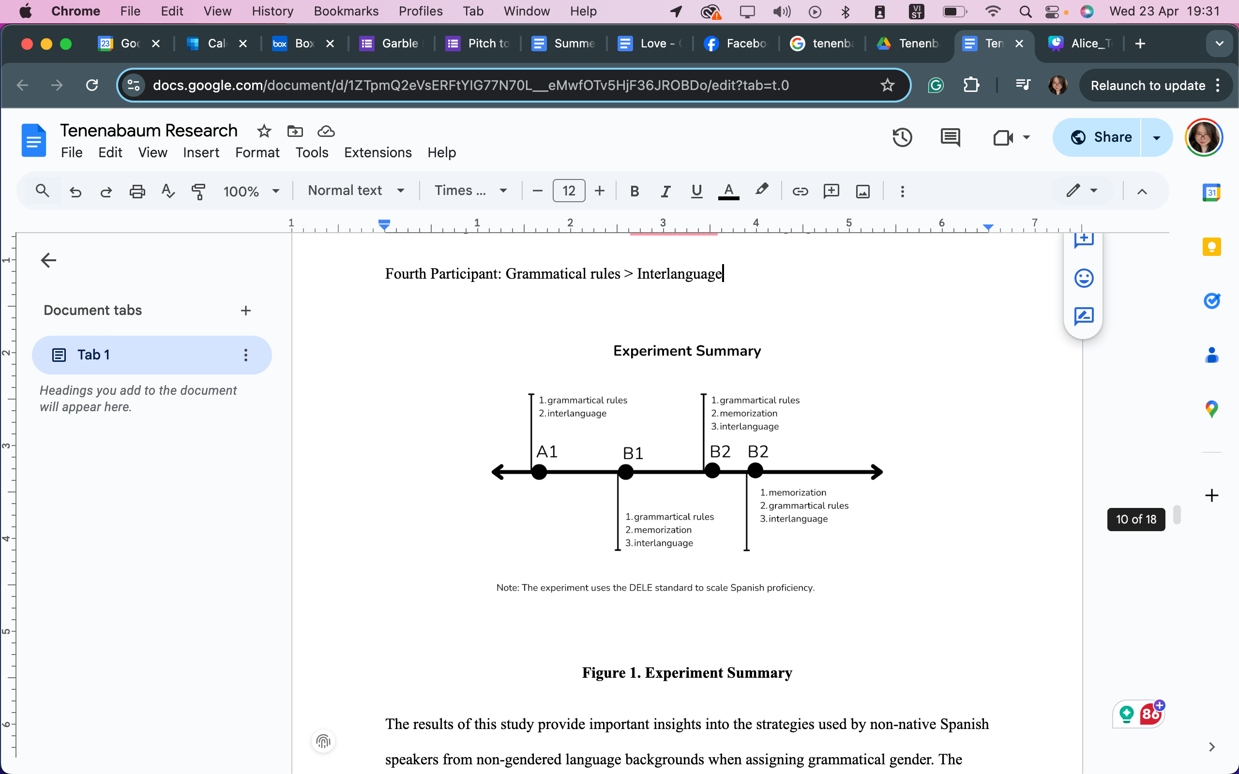
RESULT

Slide 5
CONCLUSION
  Native speakers encode gender as an intrinsic and automatic feature of nouns effortlessly as part of their mental lexicon.
  Non-native learners approach gender assignment as a cognitive challenge requiring conscious reasoning and reliance on learned rules.
  The proficiency level and exposure time to the Spanish language significantly influence strategy preferences.
  The most effective strategy is memorisation or chunking. The least is interlanguage strategy.

Slide 6
Tenenbaum Tutorials 2024-2025
THANK YOU
Presented by Ngoc Diep (Alice)
Supervisor: Professor Amy George

